Slide 1
SOFTWARE CONFIGURATION MANAGEMENT

Slide 2
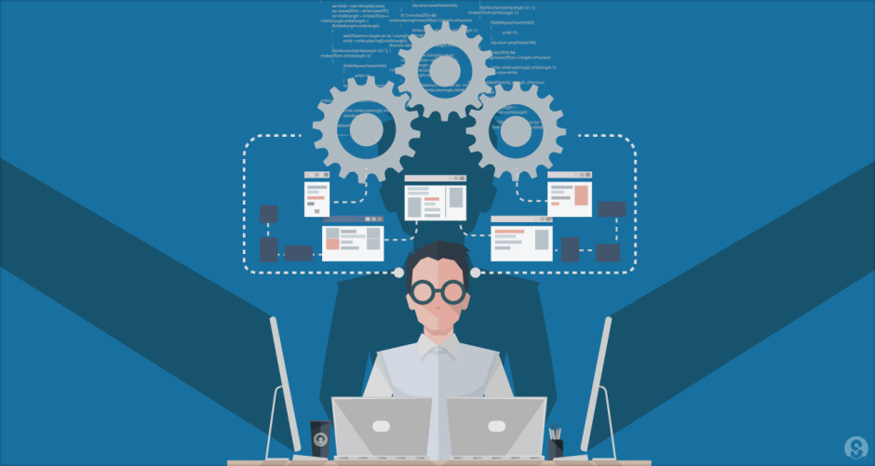
Change, Promotion, Release & Defect Management

Slide 3
Configuration Management Activities (Recap)
Configuration item identification
Configuration Management Directories
Baselining
Branch management
Version Management
Build Management
Install Management
Change Management
Promotion management
Release management
Defect Management

Slide 4
8. Change Management
A change could result in the creation of a different version or a release of the software
Deals with the changes to the Configuration Items (CIs) which have been baselined
General change process
Change is requested (anytime by anyone)
A Unique identification is associated with this change being requested (Change Id, Requestor, Date etc.) and typically logged into tools
The change is assessed for impact to other modules, branches and categorized
Decision on the change - Accepted or Rejected
All of these activities are mostly tool driven
If accepted, the change is implemented and validated
Plans done and executed for documentation, versioning, merging and delivery
The implemented change is also audited.

Slide 5
8. Change Management
The complexity of the change management process varies with the project
Small projects perform change requests informally (and fast)
Complex projects require detailed change request forms and the official approval by one or more managers or through Configuration Control Board (CCB) (which exists in large project).
Information required to process a change to a baseline would need to include
A description of the proposed changes
Reasons for making the changes
List of other items affected by the changes
Tools, resources, and training are required to perform baseline change assessment
File comparison tools to identify changes
Other Resources and training depending on size and complexity of project

Slide 6
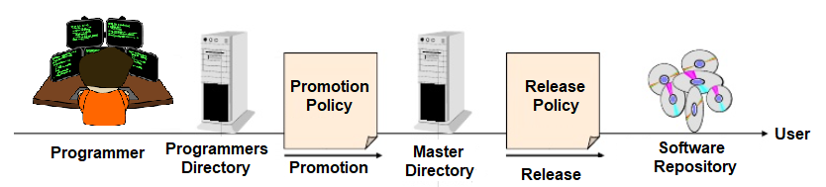
Controlling Changes :
Changes to code are typically controlled at two points
Change policies : These promotion and release change policies are approaches for controlling change. These could be
Informal (good for research type environments and promotions)
Formal approach (good for externally developed CIs and for releases)
The purpose of change policies is to guarantee that each version, revision or release conforms to commonly accepted criteria and a consistent process is applied to how things are done.
These change policies are enforced through engineering processes and tools. They are also Audited to ensure they are conformant to the processes defined.

Slide 7
9. Promotion Management
Changes made by a programmer is only available within the programmers environment and hence will need be promoted to a central master directory based on certain promotion policies.
This promotion could be based on the baselining criteria which was planned for, and would include some kind of verification of meeting the criteria. Post that it would be authorized to be promoted and moved to the Master directory, which would then be available to other dependent modules
E.g. “No developer is allowed to promote source code which cannot be compiled without errors and warnings.”

Slide 8
10. Release Policy and Management
The code in the Master directory is then released to customers and moved to the Software repository. This movement is done based on the release policies.
The release policy would be based on gating quality criteria which was planned for, and would include some kind of verification of the metrics to be meeting the criteria, post which it would be authorized to be released to the customers and archived in the software repository.
E.g. for the release policy
“No baseline can be released without having been beta-tested by at least 500 external persons.”

Slide 9
10. Release Management
Release management is an overloaded terminology. It is considered as a process of managing, planning, scheduling and controlling a software build through different stages and environments; including testing and deploying software releases.
Release management could also be looked at as making a software component to be available to a customer by deploying a system release (which is a version of a software system) to customers. Since we are looking at each of the others (Build, Install etc) independently, we are looking at the release management as deployment.
Complete Product (Major or Minor)
Components of Product
Notes:
For example: If the operating system is OS 10.9.2. This means minor release 2 of major release 9 of OS 10.

Slide 10
10. Release Management : Patches
A patch is a set of changes to a computer program or its supporting data designed to update, fix, or improve it.
This includes fixing security vulnerabilities and fixing other bugs (for bug fixes.)
Patches are often written to improve the functionality, usability, or performance of a program.
Generic Patch
These also could be binary patches, source code patches
Hot fix
Emergency or Site Specific Patch
Unofficial patch
Patch Bundle
Service pack - A service pack or SP or a feature pack (FP) comprises a collection of updates, fixes, or enhancements to a software program delivered in the form of a single installable package
Notes:
For example: If the operating system is OS 10.9.2. This means minor release 2 of major release 9 of OS 10.

Slide 11
Version Vs Revision Vs Release
Release:
The formal distribution of an approved version.
Version:
An initial release or re-release of a configuration item associated with a complete compilation or recompilation of the item. Different versions can have different functionality.
Revision:
Change to a version that corrects only errors in the design/code, but does not affect the documented functionality.
The usage of the terminology presented here is not strict but varies for different configuration management systems.
A 3 digit scheme is quite common:
7.5.5
Release
(Customer)
Version
(Developer)
Revision
(Developer)

Slide 12
11. Bug or Defect Management - 1
Bug is an consequence of a coding fault
Defect is a variation or deviation from the expected business requirements to have been implemented
Approaches to manage these would be similar and involve following the Defect Management Process & Generation and considerations of Metrics
All of this bug/defect management is often driven through the defect management steps in usage of tools like Bugzilla

Slide 13
11. Bug or Defect Management - 2
Defect Management Process would contain the following steps
Discover
Reporting, logging into the tool (if being used) with an unique identifier
Validation
Analysis and Categorization (Critical, High, Medium and Low)
Request and Approval for fix or change
Resolution (Assignment, Schedule, Fix, test and report on resolution)
Verification by submitter
Merging of the code
Updating of the version number
Plan for release of the fix to the customer
Closure
Reporting

